Slide 1
edstudiO intrO tO videO
with david howlett
RESOLUTION - FRAME RATE - FILE FORMAT - EQUIPMENT
FILMING - FILE MANAGEMENT - EDITING - EXPORTING

Slide 2
PRE - PRODUCTION

Slide 3
RESOLUTION
Digital images are made up of thousands of pixels.
The resolution of an image is determined by how many pixels make it up, and what the dimensions are.
Full HD is 1920x1080 pixels (1080p). It is considered the current standard.

Slide 4
TRIVIA TIME!
What is the simplest way of expressing the ratio 1920 : 1080?
What does the “p” in 1080p stand for?
What are the lowest and highest resolutions YouTube allows?

Slide 5
TRIVIA TIME!
16:9
Progressive!
No minimum for upload, auto scales up to 144p (256x144)
8k (7680 x 4320 pixels)

Slide 6
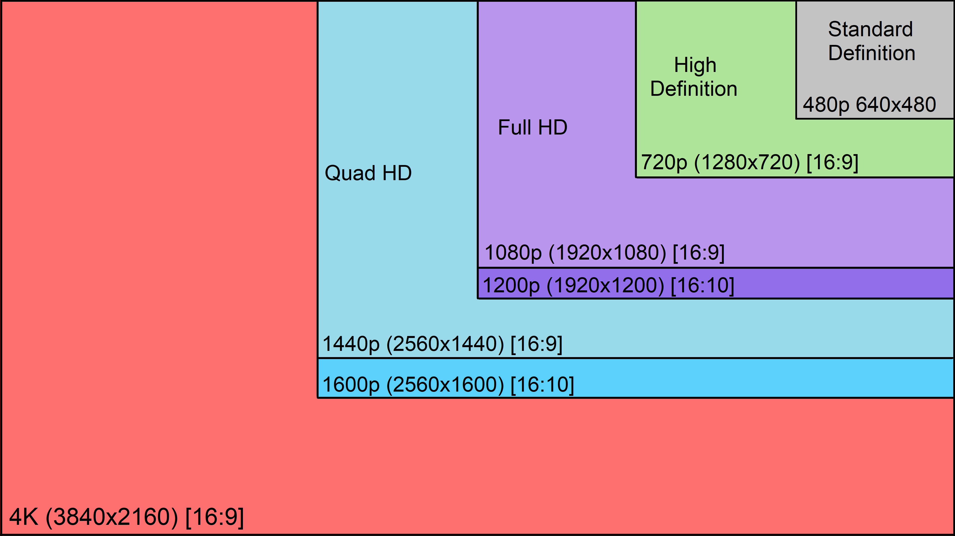
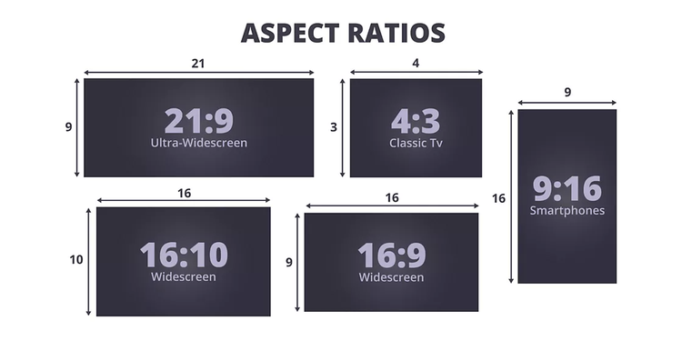
RESOLUTIONS – ASPECT RATIOS
What resolution/aspect ratio will your video be watched in (hopefully)?
That’s probably the resolution you want to film in.

Slide 7
A TIP FROM SOME RANDO I’M CHOOSING TO TRUST
Professor Hartman
Dad/Husband/Designer/Filmmaker/INFJ/Coffee Addict
Author has 8.7K answers and 12.3M answer views
3y
To avoid the dreaded YouTube compression algorithm that’s highly compressed, upload in 4K even if your timeline is originally 1080p, which in most applications is the norm.
What does this do? It tells the YT algorithm to use the next quality tier of compression which is higher than that of 720 and 1080. Most users are going to consume the 720 or 1080 version anyway, regardless if there’s a UHD 4K option available. All you’re trying to do here is trip YT into the second quality tier so that your 720 and 1080 consumption will suffer with less compression artifacts.
This has been a wide complaint for decades in general. YT isn’t budging on this one. So you have to cheat or upload to Vimeo if retaining more quality is important to the experience.

Slide 8
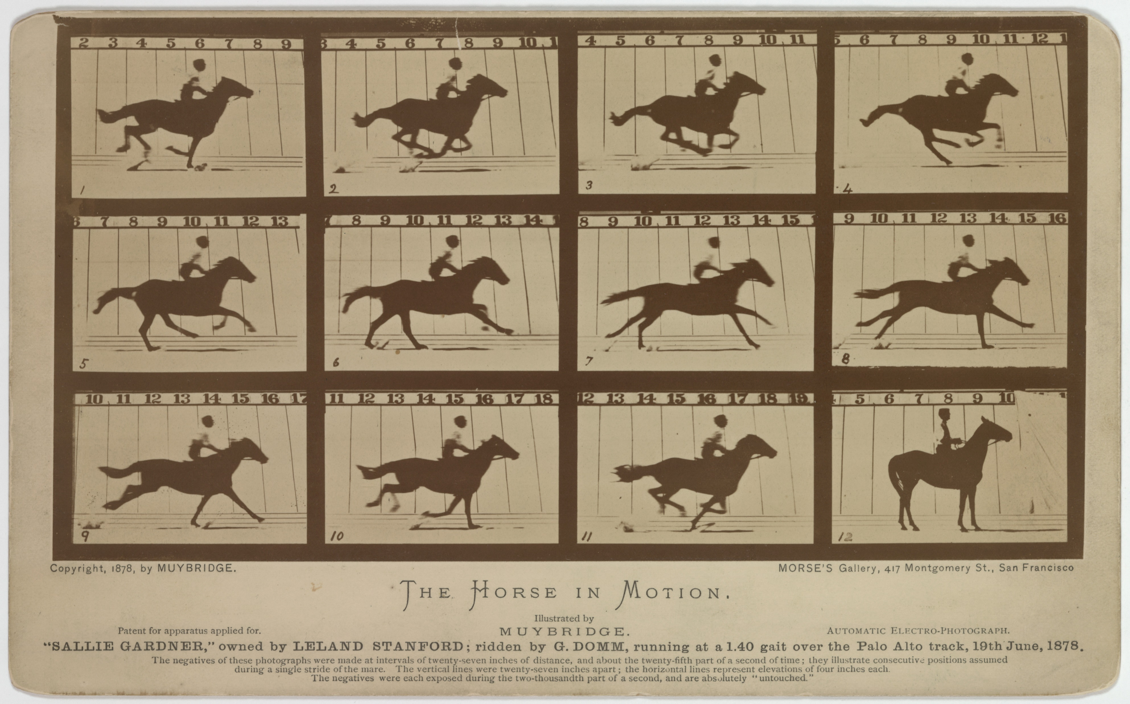
FRAME RATE
Frames per second (FPS)
Videos are all made of still images in quick succession. But how quick?
24fps
30fps (iPhone video default)
60fps
Is more better?

Slide 9
FILE FORMAT
MP4 – Most common, therefore most supported, smaller file sizes, best for most cases
MOV – Apple proprietary. Bigger file sizes. Good if only using Apple products, can very occasionally cause issues otherwise

Slide 10
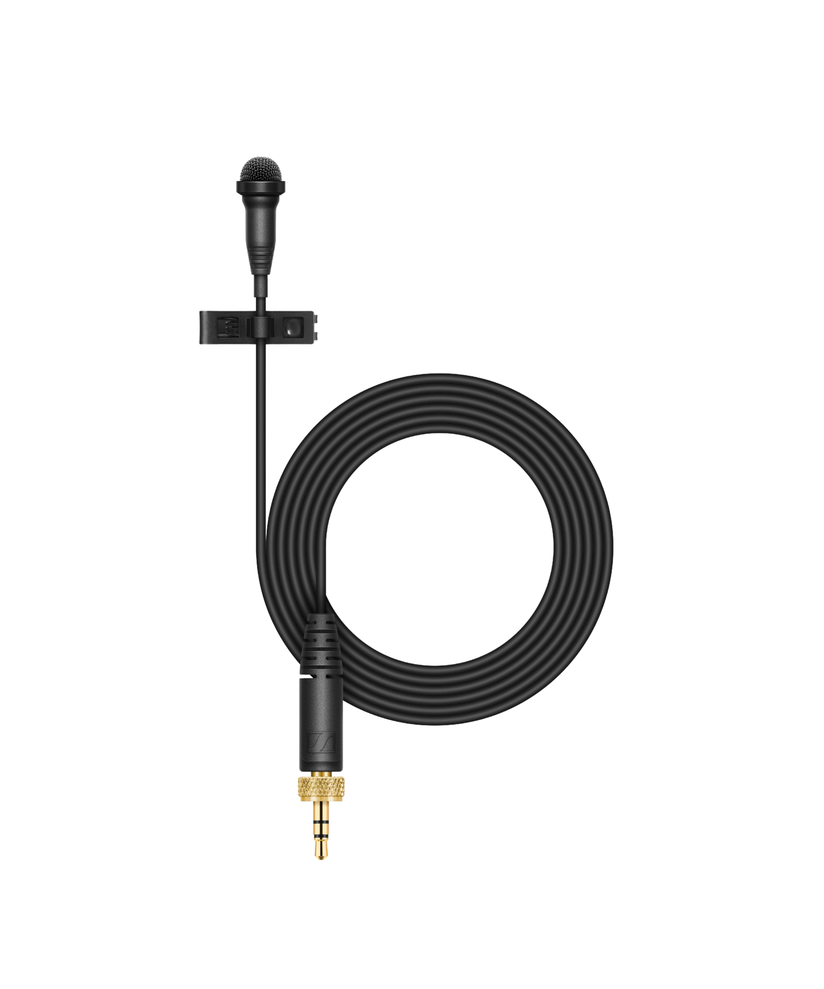
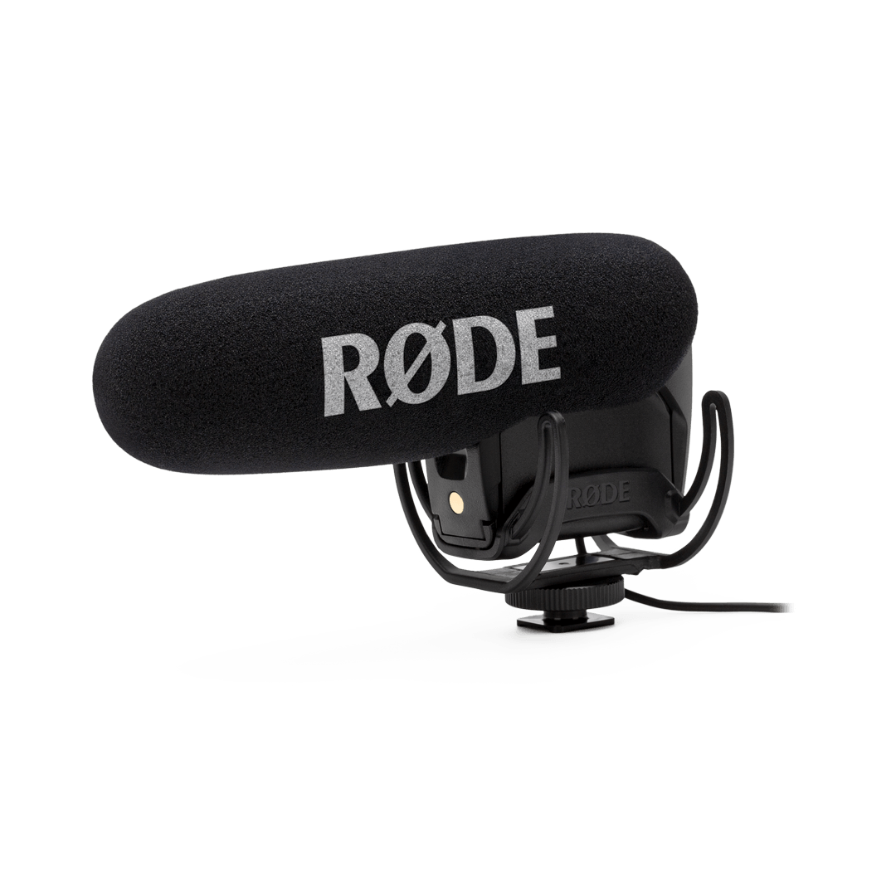
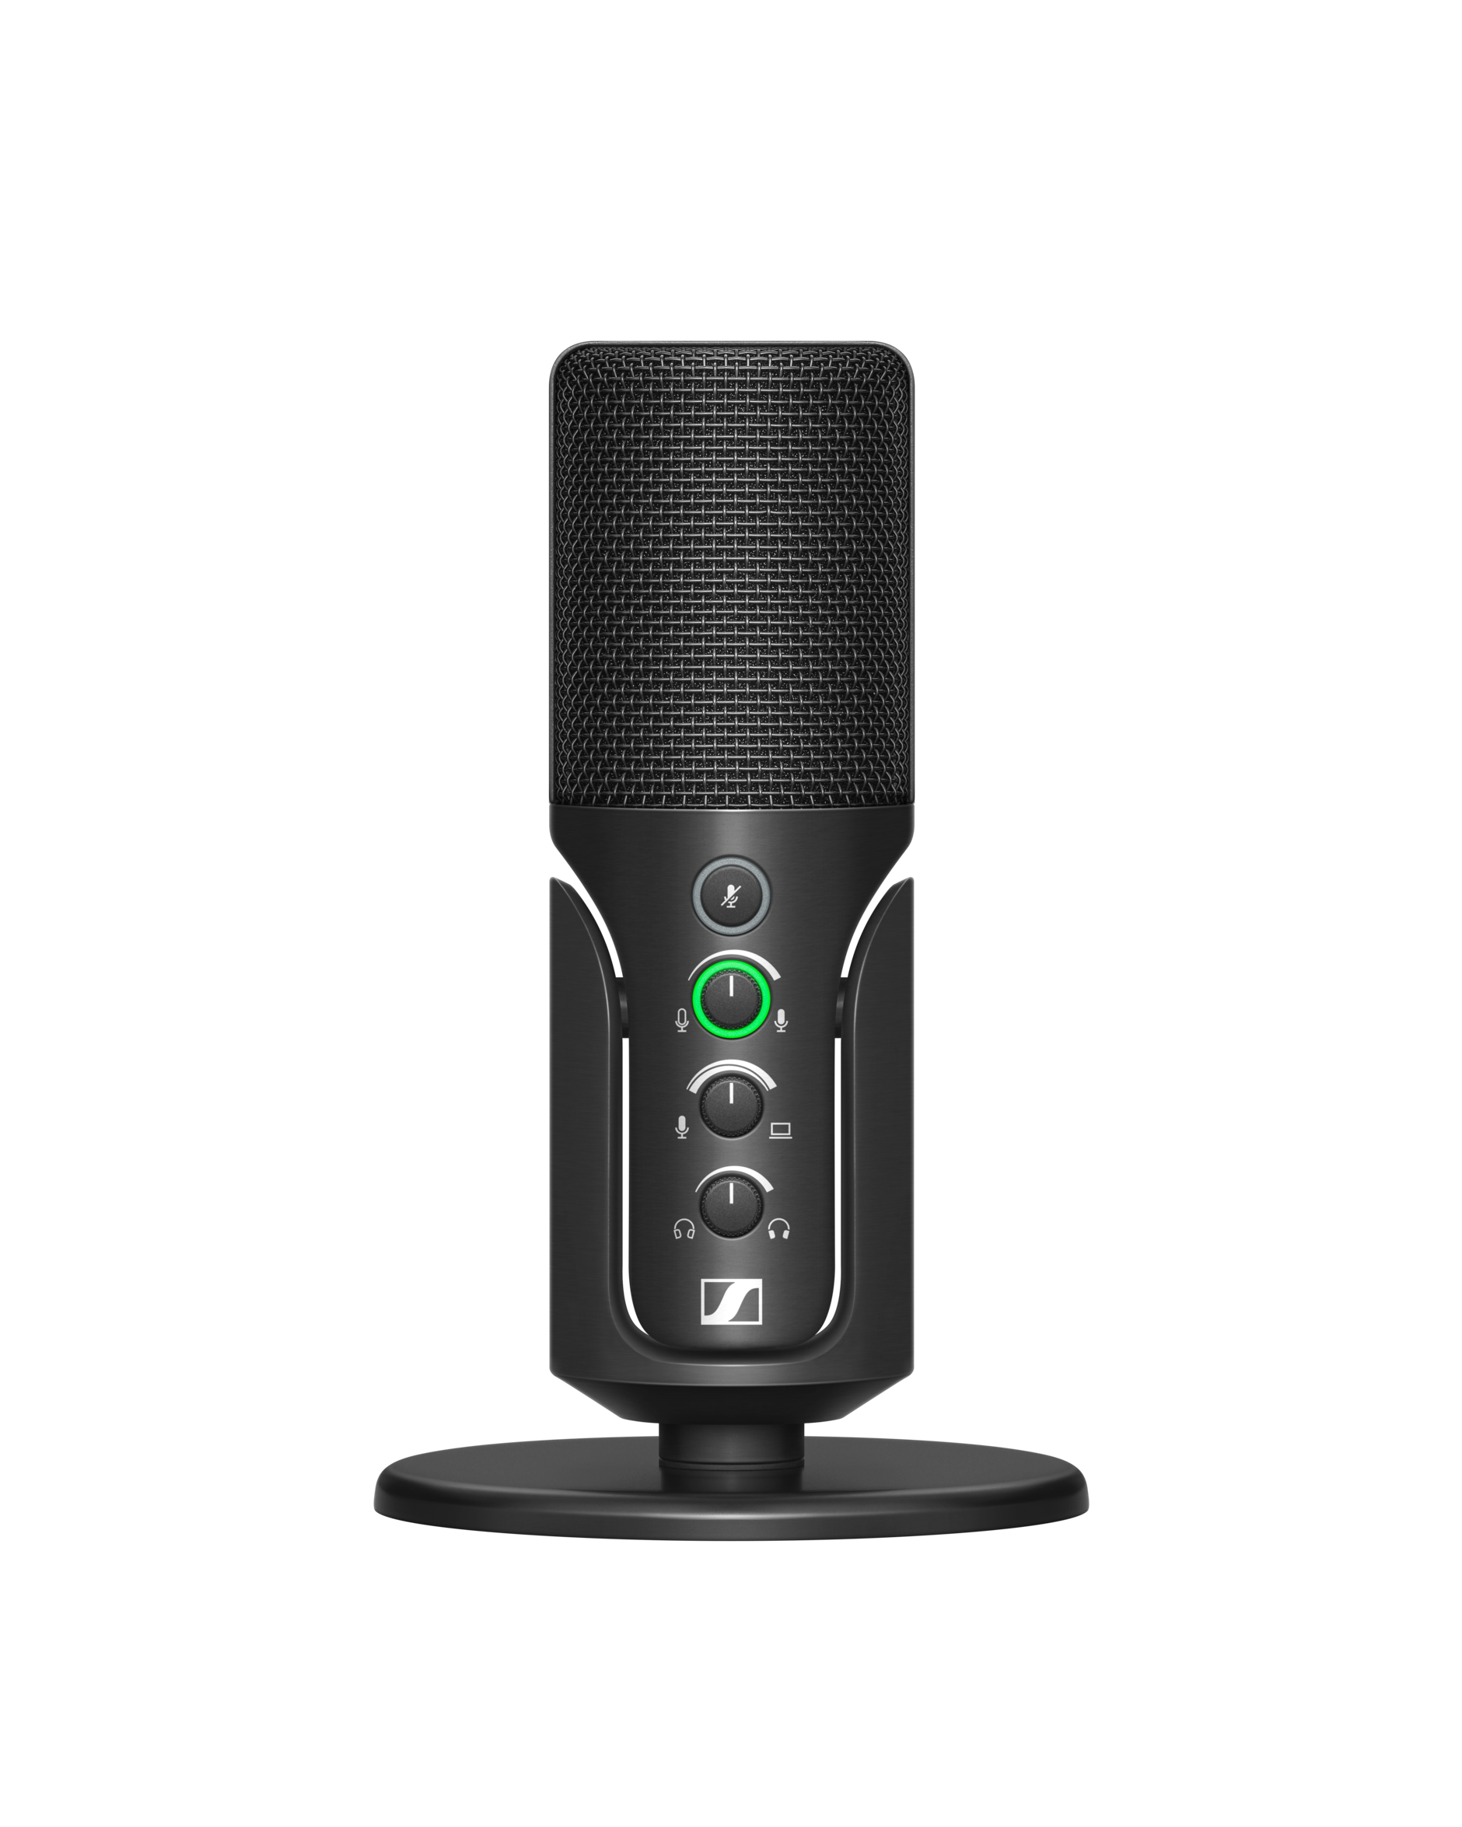
EQUIPMENT
Phone cameras are pretty good these days!
If you have access, use a video camera or DSLR
External Microphones are probably the biggest upgrade to production value

Slide 11
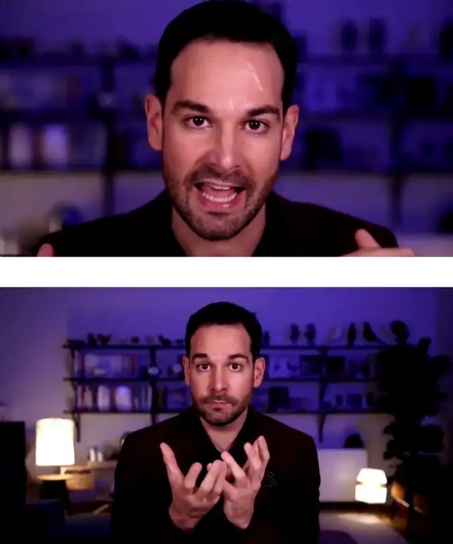
FILMING
Be aware of background noise
LIGHTING!!!
Framing (keep headroom)
Make sure your camera is static
Rehearse a couple times
Do a few takes

Slide 12
FILE MANAGEMENT
BACK IT UP!!!
Transfer through USB (best) or Google Drive, OneDrive, iCloud, etc. NOT GMAIL OR MESSENGER!
Practice “non-destructive” editing
Don’t overwrite when exporting
No more myvideoRe-editFINALfinal.mp4, use 01, 02, 03…

Slide 13
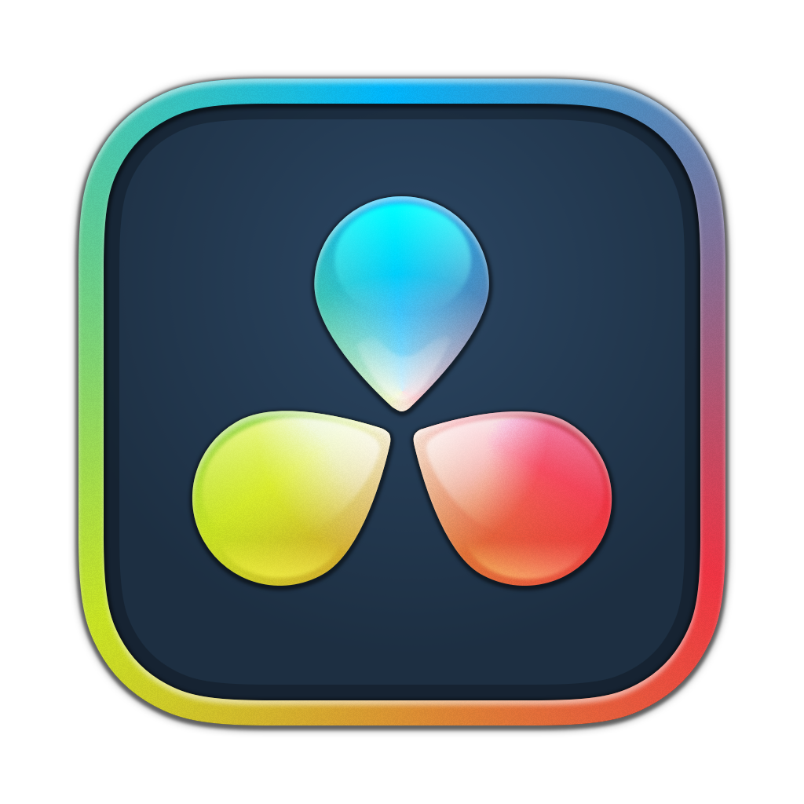






EDITING
DaVinci Resolve:
-Free
-Amazing
-Becoming industry standard
-Requires good computer
-Not the most beginner friendly
Shotcut:
-Free
-Good
-Open source
-Beginner friendly
Capcut:
-Free
-Ok
-Popular
-Templates
-Web version
-Lots of limitations
-Watermarks???
-ByteDance
Clipchamp/iMovie
-Free
-They edit videos!
-Honestly not bad

Slide 14
EXPORTING
BACK IT UP!!! DON’T OVERWRITE!!!
Match your timeline and export settings to your video capture settings whenever possible
Most editing programs have purpose-built export default settings (YouTube, FHD, Instagram reel, etc.)
When in doubt: H.264, .mp4, 1920x1080p

